Slide 1
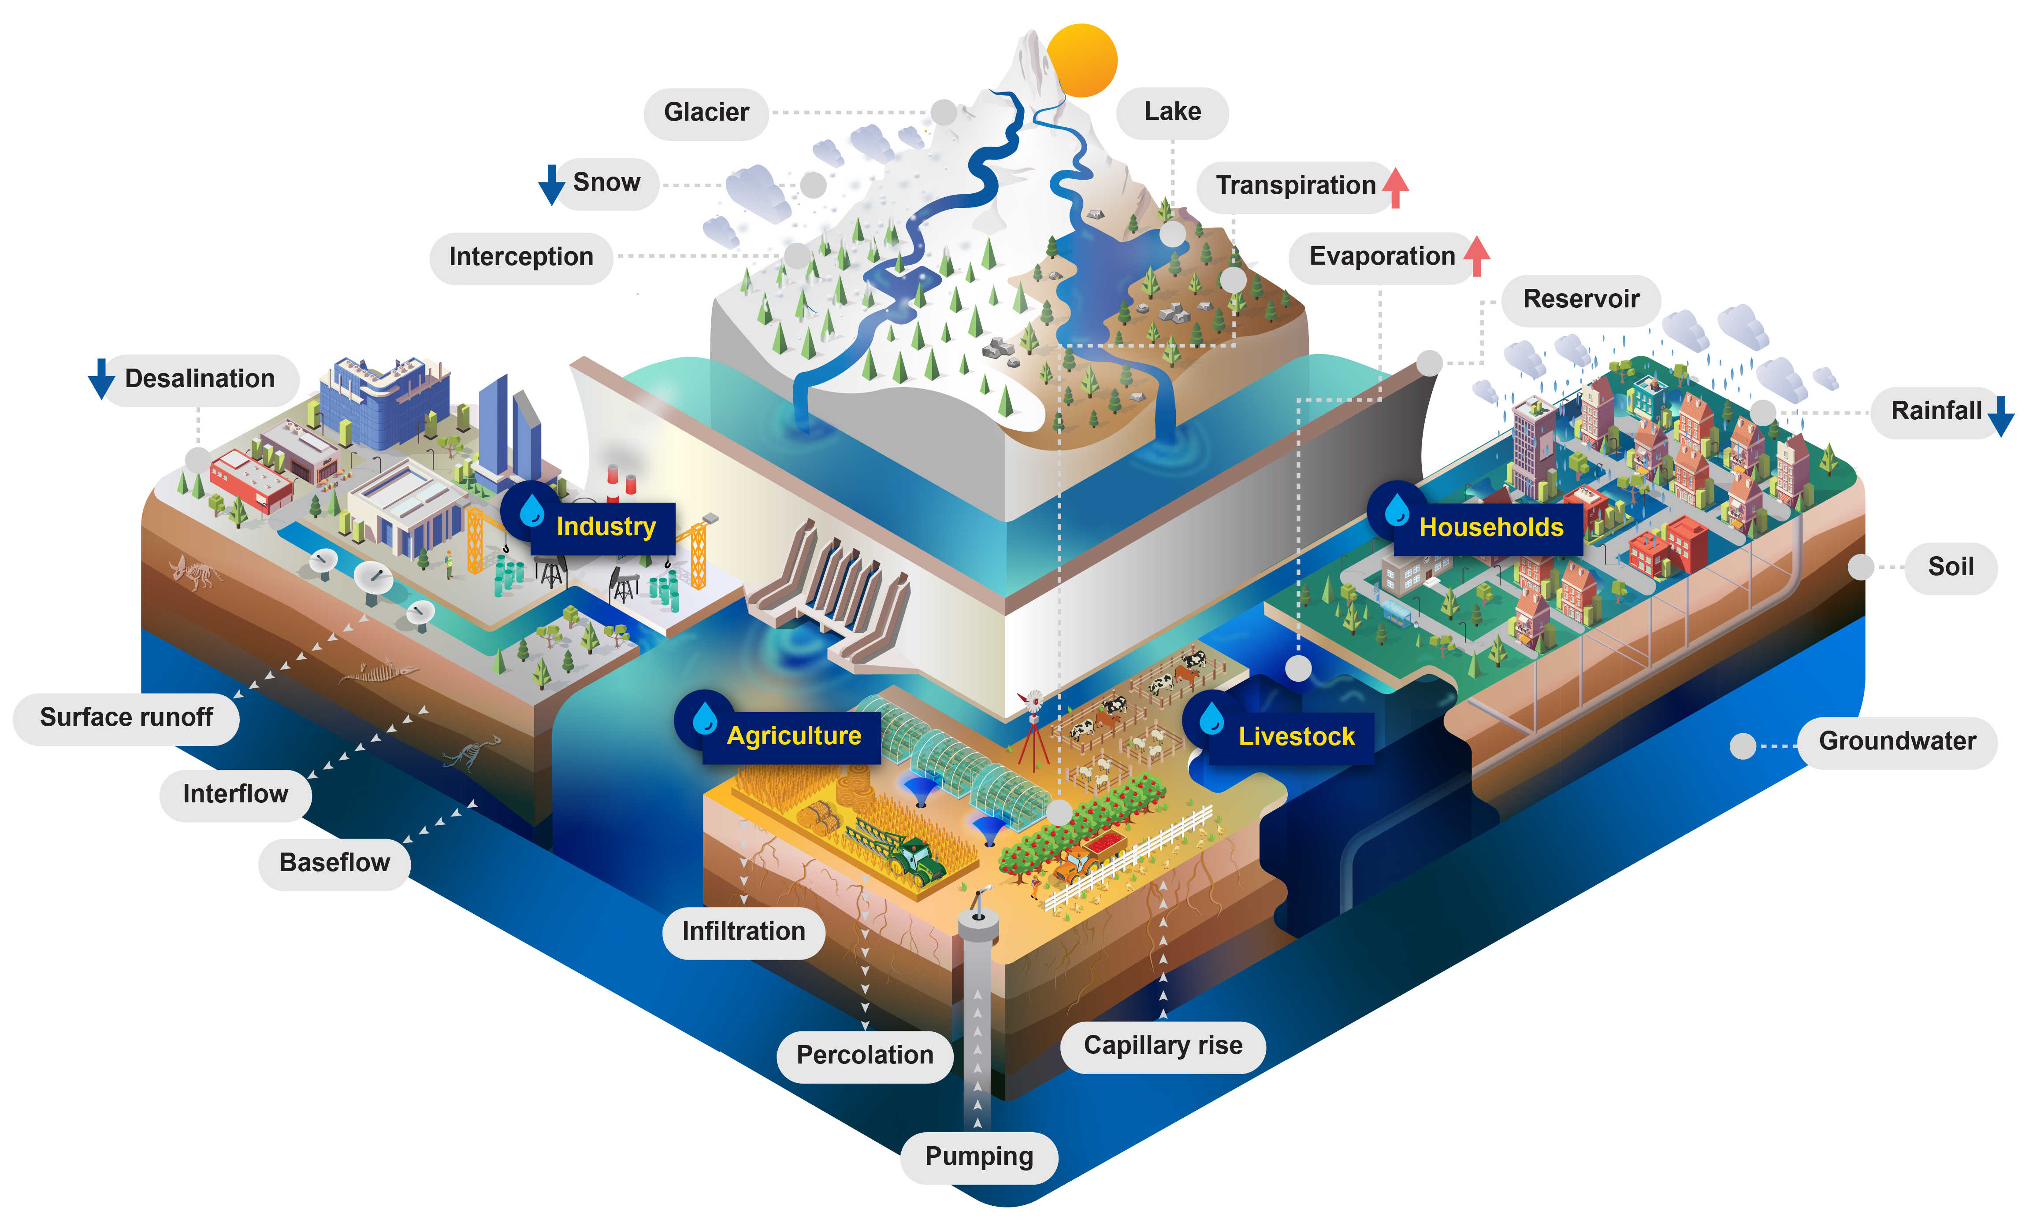
The Community Water Model (CWatM)
The Community Water Model (CWatM) is an open-source process-based hydrological model developed at IIASA
A region is simulated as a connected grid of cells where the water fluxes within and between cells at a daily timestep.

Slide 2
Nira river sub-basin
What follows are highlights and preliminary results from setting up CWatM on the Nira river sub-basin, including:
River discharge
Reservoirs
Evapotranspiration
Groundwater pumping
Canal leakage

Slide 3
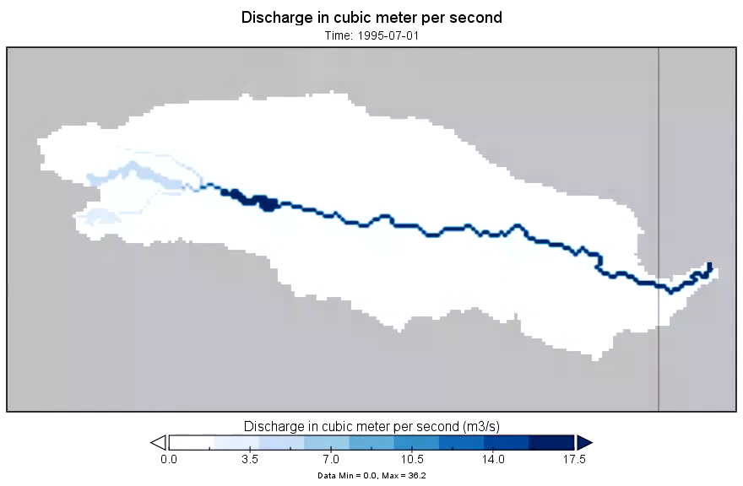
River discharge
River discharge is one of the main outputs of interest, and river gauge data at a location towards the end of the sub-basin is currently used to calibrate the model.
This video illustrates river discharge in the Nira river sub-basin for one year, beginning with the Monsoon.
Routing is simulated using the kinematic-wave approach at a sub daily timestep.

Slide 4
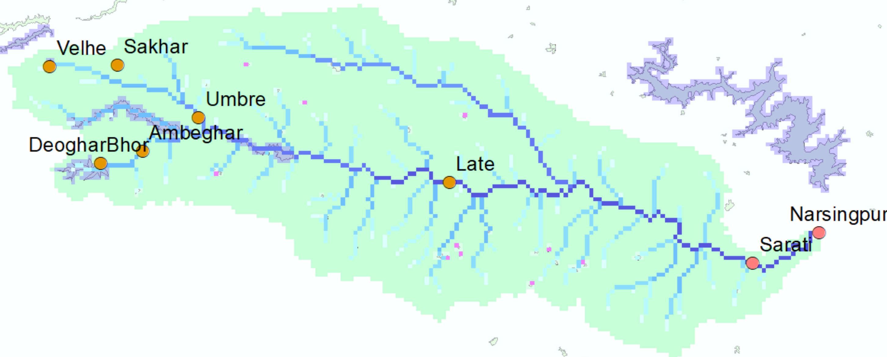
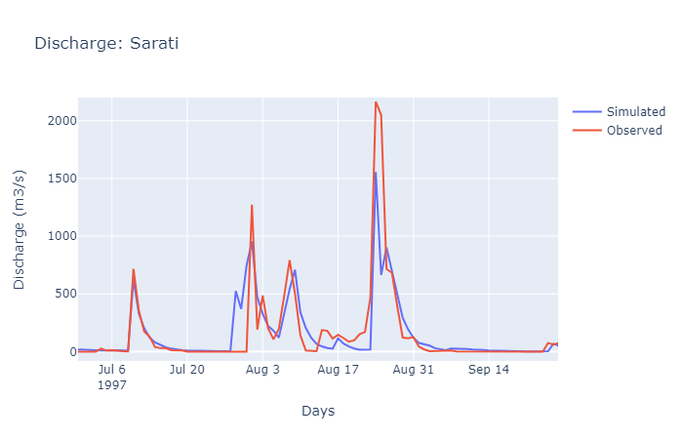
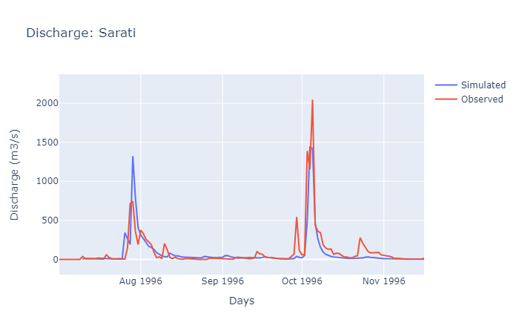
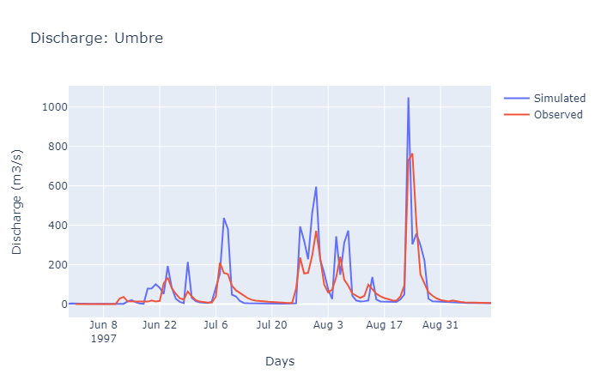
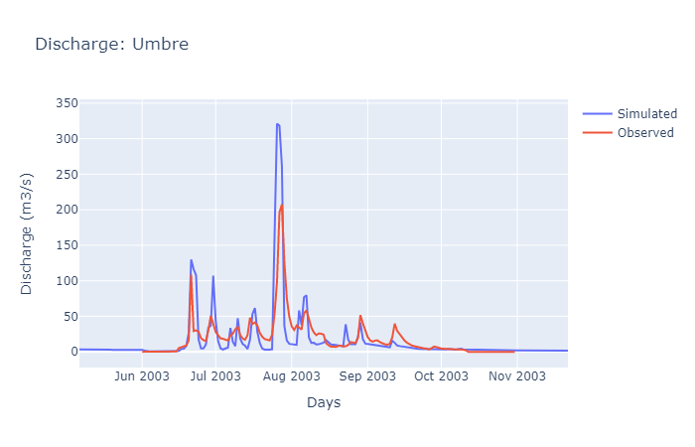
Here, simulated river discharges examples are presented alongside observed data for two station locations.
The model is currently achieving a Kling-Gupta efficiency of 0.5 at the calibration station of Sarati across the 10 years of observed data.

Slide 5
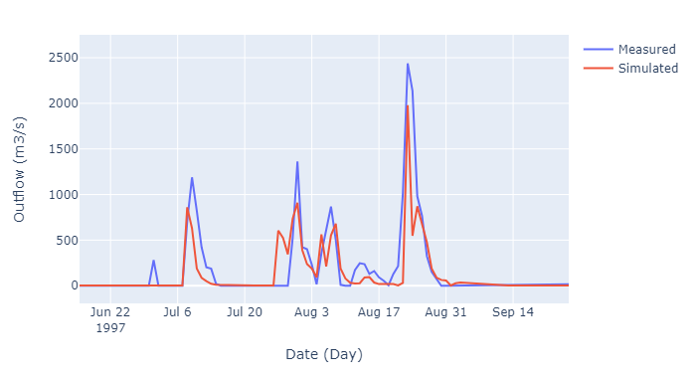
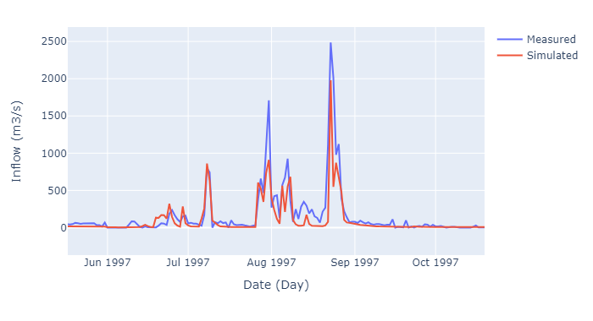
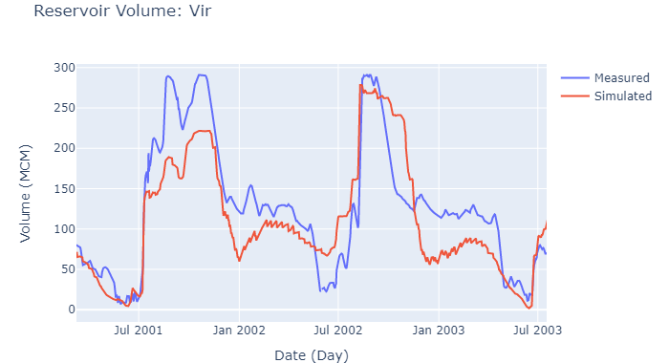
Reservoirs
Reservoir releases are currently related to the relative volume of the reservoir and depend on different thresholds of capacity.
Data related to outflows, inflows, and volumes are not necessarily sufficient to determine how release decisions were and are made.
We are challenged to understand how reservoir operating decisions are made, both to simulate historical conditions, and to appropriately simulate such potential decision making.

Slide 6
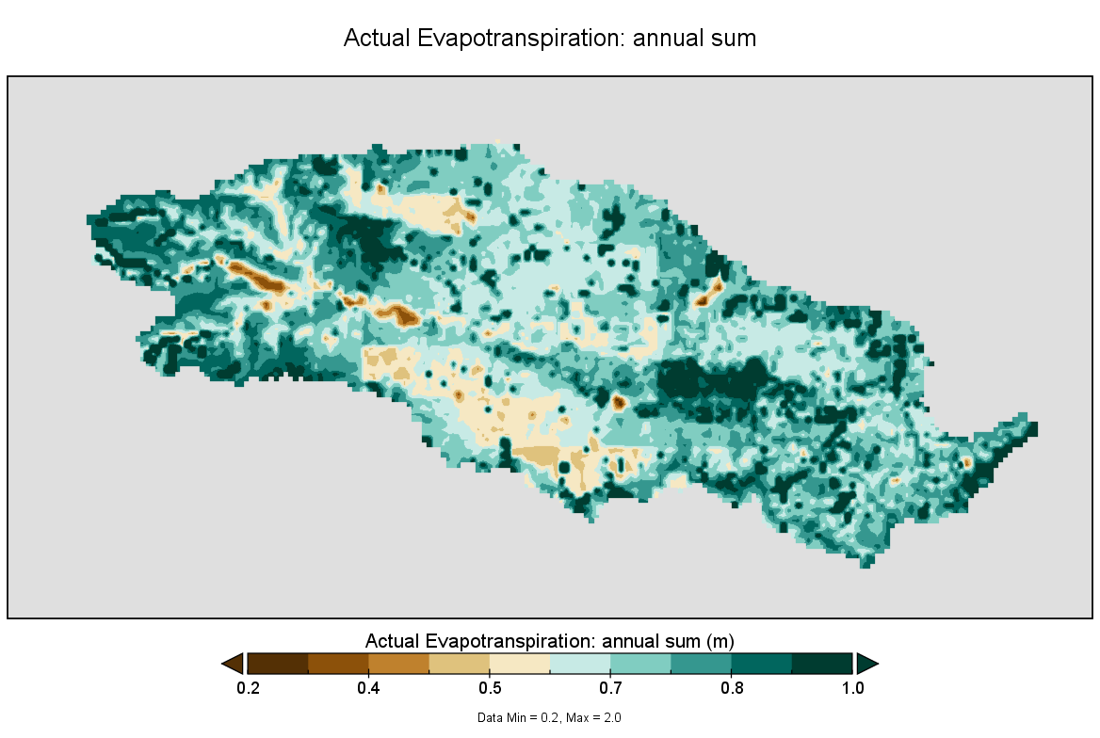
Evpotranspiration
Evapotranspiration is estimated based on stage-specific crop coefficients and potential evapotranspiration with Penman-Monteith.
Currently, sugarcane, sorghum, and rice are simulated specifically, with other crops grouped together.

Slide 7
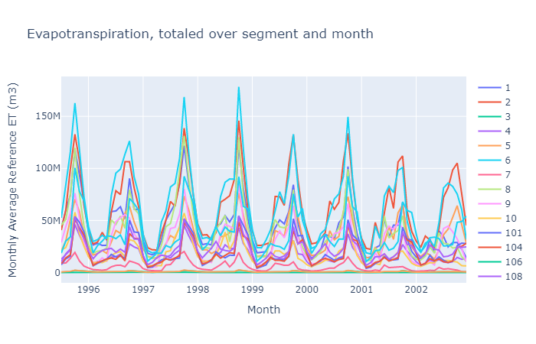
Evapotranspiration, spatial-unit specific
Decisions in the model are to be made generally at the Taluka level. It is then important to aggregate certain variables, evapotranspiration as an example, to determine how this administrative unit will respond.
These images illustrate the timeseries of evapotranspiration per administrative unit over several years, as well as the map of administrative units within the Nira river sub-basin.

Slide 8
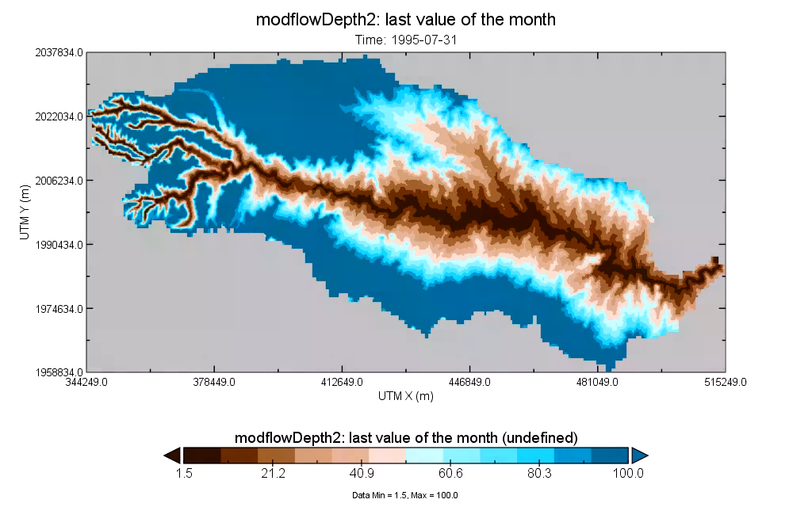
Groundwater pumping
Depth to groundwater
Groundwater pumping to satisfy water demand influences the water table of the surrounding area.
This clip shows an example of significant groundwater abstraction.

Slide 9
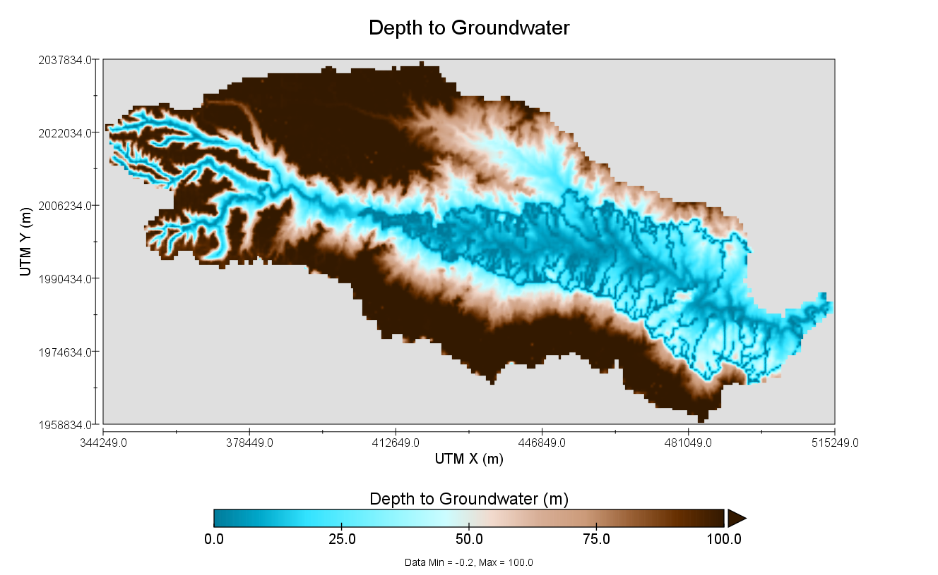
Canal leakage
Depth to groundwater
Canal leakage has been identified as a significant influence on the hydrological cycle.
Reservoir-specific leakage coefficients determine the fraction of delivered reservoir water that leaks along the associated canal system.
This image illustrates the effect of significant canal leakage on locally raising the groundwater table.

